Slide 1
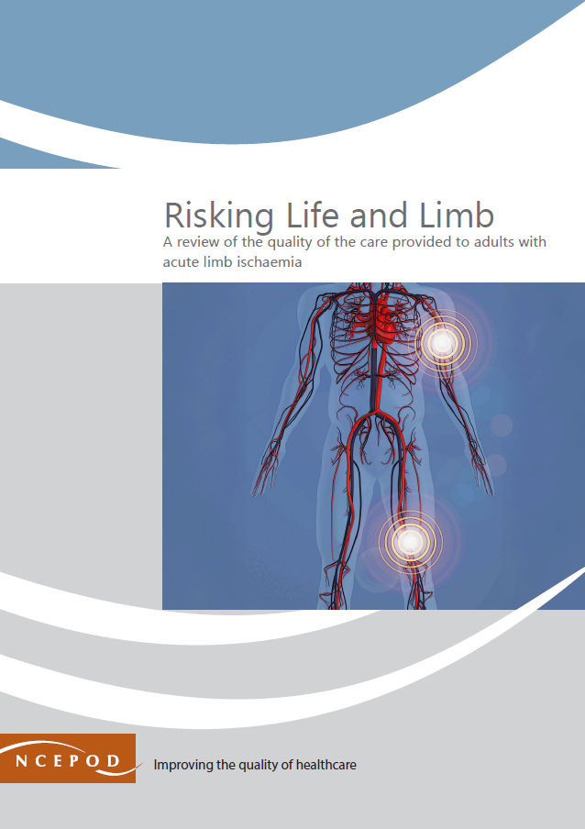
A review of the quality of care provided to adults with acute limb ischaemia
Key messages and recommendations

Slide 2
The study
Study population:
Adults over the age of 18 years who were admitted to a vascular hub as an emergency, between 1st January 2023 and 31st March 2023 for treatment of ALI.
Data sources:
293 clinician questionnaires
111 primary care questionnaires
156 organisational questionnaires
51 vascular hub
105 spoke hospital
330 sets of case notes

Slide 3
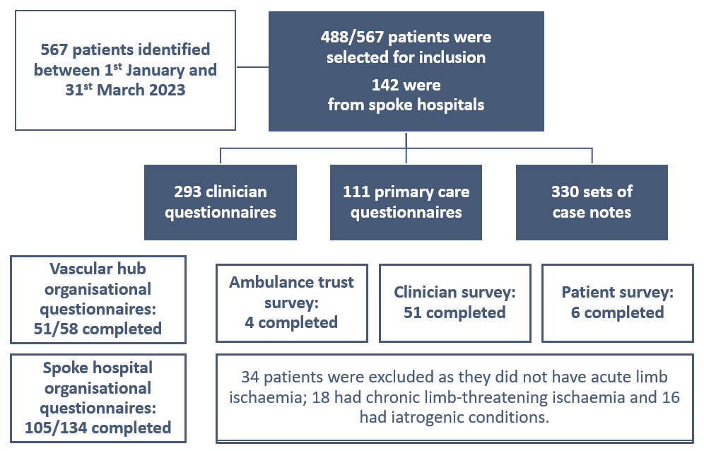
Data returns

Slide 4
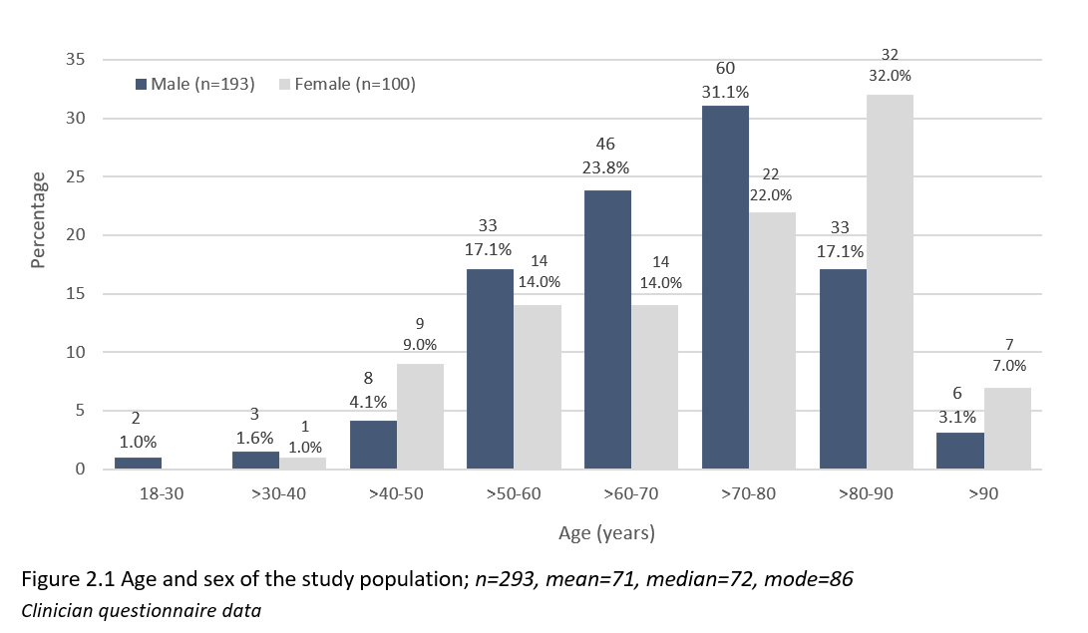
Age and sex of the study population

Slide 5
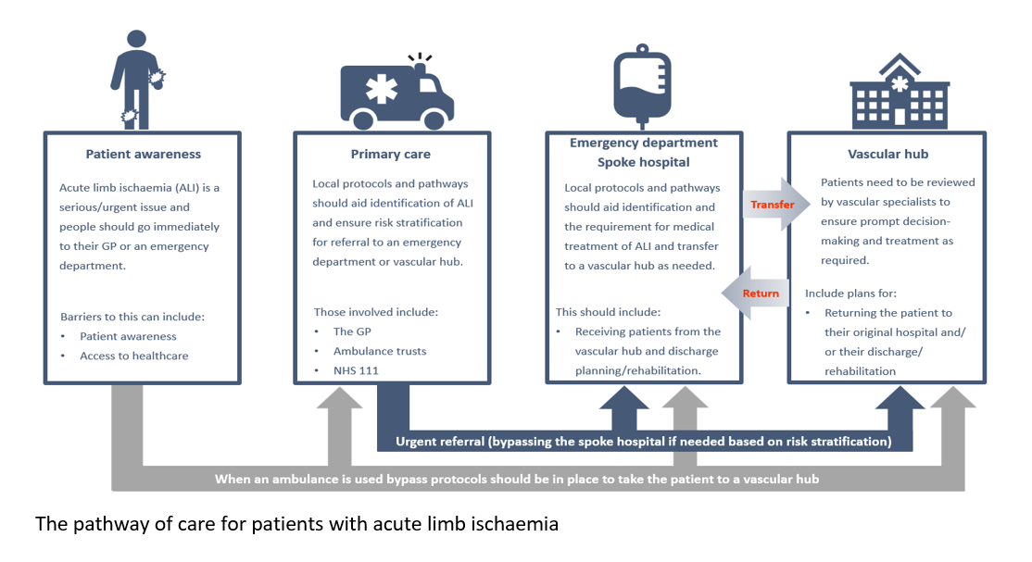
Pathway of care

Slide 6
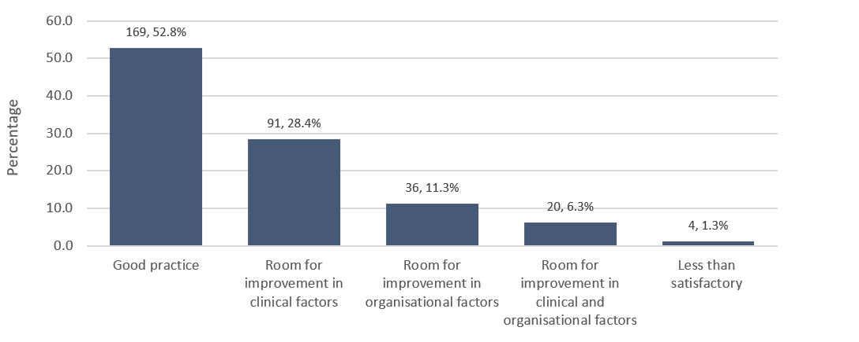
Overall quality of care

Slide 7
KEY MESSAGES

Slide 8
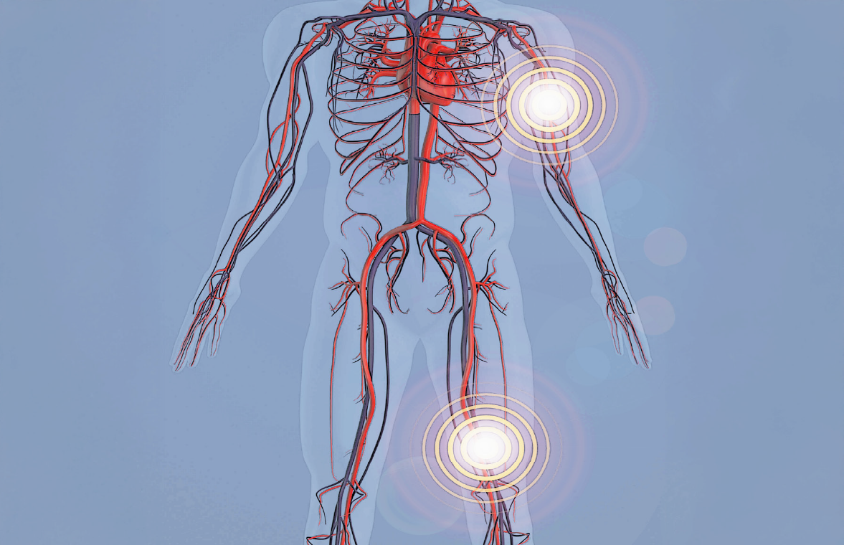
1
Recognise acute limb ischaemia and what prompt actions to take to reduce any delay in treatment and potentially save the limb.
Delays occurred throughout the patient pathway due to a lack of recognition of the symptoms of acute limb ischaemia by both healthcare professionals and patients with the condition.
Delays to presentation were common with 144/283 (50.9%) patients presenting more than 24 hours after the onset of their symptoms.
There were missed opportunities to recognise ALI prior to admission, most commonly due to a lack of patient awareness (82/115; 71.3%) and/or recognition in primary care (24/115; 20.8%).

Slide 9

2
Refer or transfer patients with new or worsening symptoms of acute limb ischaemia who are at high risk of losing their limb directly to a vascular hub.
Patients most likely to benefit from an intervention (Rutherford category IIb) were not always directed to a vascular hub, delaying their treatment beyond the accepted target of six hours.
The median time from arrival at the spoke hospital to arrival at the vascular hub was 8.16 hours, exceeding the time from development of symptoms to treatment target for immediately threatened limbs.
Using an ALI pathway in the vascular hub appeared to have a positive impact on care by reducing review delays.

Slide 10
3
Organise vascular networks to provide timely access to vascular specialists skilled in treating people with acute limb ischaemia.
Networks were underused and non-vascular specialists reported not being confident to treat patients in the spoke hospitals but had no formal transfer option to the vascular hub.
There were 34/91 spoke hospitals in which medical records could be shared electronically and 56/91 in which images could be shared immediately. All other systems that were described, such as email and paper copies, risk delays or other harm.
In total, 138/330 (41.8%) patients attended a spoke hospital and were then transferred to a vascular hub.

Slide 11
4
Develop a national guideline for the management of acute limb ischaemia.
There is no national guideline covering the care pathways between primary care, spoke hospitals and vascular hubs for patients with acute limb ischaemia.
Written guidance specific to the management of suspected ALI was available in only 56/91 spoke hospitals, and when it did exist key components were often missing.
Using an ALI pathway in the vascular hub appeared to have a positive impact on care: 3/46 (6.5%) patients experienced a delay on an ALI pathway compared to 18/165 (10.9%) not on a pathway.

Slide 12
5
Capture focused data on acute limb ischaemia, to report on procedures and outcomes for patients with ALI.
There is no clinical code for acute limb ischaemia and no registry to record data locally, therefore the true number of patients with ALI is unknown, leading to an absence of data to promote improvement in patient outcomes.
Only 22/47 vascular hubs stated they recorded data on surgical procedures and 19/42 on interventional radiological procedures.
The use of prospectively collected data for shared learning was uncommon with most learning occurring in morbidity and mortality meetings or due to reported adverse events.

Slide 13
RECOMMENDATIONS

Slide 14
Raise awareness of acute limb ischaemia, how to recognise it and what actions to take to reduce delays in the treatment pathway.
Raise awareness with patients and the public about the symptoms and who to contact.
Raise awareness with healthcare professionals in primary care, community care and all emergency departments (vascular hubs and spoke hospitals).
For action by: PATIENT AND PUBLIC AWARENESS
The Office for Health Improvement and Disparities (previously Public Health England), Public Health Wales, Public Health Agency Northern Ireland, Public Health Jersey.
CLINICAL AWARENESS
Commissioners (including NHSE Vascular Services clinical reference group) and integrated care boards in discussion with their trusts/health boards.
Additional stakeholders: Vascular Society, British Society of Interventional Radiology, NHS 111, Royal College of Surgeons of England, Royal College of Anaesthetists, Association of Surgeons of Great Britain and Ireland, Association of Anaesthetists, Royal College of General Practitioners, Royal College of Emergency Medicine, Royal College of Physicians, Royal College of Radiologists, British Society of Endovascular Therapy, Association of Ambulance Chief Executives, Joint Royal Colleges Ambulance Liaison Committee, Royal College of Nursing, Diabetes UK, Legs Matter, The Patients Association.
Notes:
RATIONALE FOR THE RECOMMENDATION: Delays occurred throughout the patient pathway due to a lack of recognition of symptoms of acute limb ischaemia by the patients and delays in recognition and diagnosis of acute limb ischaemia on behalf of the healthcare professionals. Delays can lead to amputations and should be avoided wherever possible.

Slide 15
Risk stratify and refer/transfer patients with symptoms of acute limb ischaemia and new sensory or motor impairment* directly to a vascular hub.
*These would be patients with a Rutherford IIb category, affecting more than the toes
For action by: Commissioners and integrated care boards in discussion with their trusts/health boards.
Additional stakeholders: Vascular Society, British Society of Interventional Radiology, Royal College of Surgeons of England, Royal College of Anaesthetists, Association of Surgeons of Great Britain and Ireland, Association of Anaesthetists, Royal College of General Practitioners, Royal College of Emergency Medicine, Royal College of Physicians, Royal College of Radiologists, Royal College of Nursing, Association of Ambulance Chief Executives, Joint Royal Colleges Ambulance Liaison Committee.
Notes:
RATIONALE FOR THE RECOMMENDATION: Patients likely to benefit most from an intervention (Rutherford category IIb) were not always directed to a vascular hub, causing a delay in their treatment beyond the accepted target of six hours. Furthermore, the Rutherford classification was rarely used outside of vascular hubs.
This also links with recognition in recommendation 1.

Slide 16
Organise vascular networks to provide timely access to vascular specialists skilled in treating people with acute limb ischaemia.
For action by: Commissioners/integrated care boards with the hospitals in their trusts/health boards
Additional stakeholders: Royal College of Surgeons of England, Vascular Society, Royal College of Anaesthetists, Association of Surgeons of Great Britain and Ireland, Association of Anaesthetists, Royal College of General Practitioners, Royal College of Emergency Medicine, Royal College of Physicians, Royal College of Radiologists, Association of Ambulance Chief Executives, Joint Royal Colleges Ambulance Liaison Committee.
Notes:
RATIONALE FOR THE RECOMMENDATION: Networks were under used and non-vascular specialists reported not being confident to treat patients in the spoke hospitals but had no formal transfer option to the vascular hub.

Slide 17
Develop a national guideline for the management of acute limb ischaemia.
For action by: Commissioners/integrated care boards with the hospitals in their trusts/health boards
Additional stakeholders: Royal Colleges of Physicians, Royal College of Emergency Medicine, Society for Acute Medicine, Royal College of Surgeons, Association of Surgeons, Royal College of Nursing, Faculty for Intensive Care Medicine, Intensive Care Society, Royal Pharmaceutical Society
Notes:
RATIONALE FOR THE RECOMMENDATION: There is no national guideline covering the care pathway for patients with, or at risk of ALI from primary care to spoke hospital to vascular hubs. In addition, there is no national data collection system and no quality improvement framework. In severe cases (Rutherford IIb), patients need to be treated by specialist staff within six hours of their symptoms appearing.

Slide 18
Support the national vascular registry to capture focused data on acute limb ischaemia, and to report on procedures and outcomes for patients with ALI*
*ICD-11 will be mandated in the UK in the next five years and has codes for upper and lower ALI that will allow data comparisons with the national vascular registry data and national patient episode data, unlike ICD-10 where ALI is coded with chronic limb-threatening ischaemia.
For action by: Funders and commissioners of the national vascular registry, working with the Royal College of Surgeons of England and partners as the current contract holder for the registry.
Additional stakeholders: Vascular Society, British Society of Interventional Radiology, NHSE Vascular Services Clinical Reference Group, Vascular Anaesthetic Society of Great Britain and Ireland
Notes:
RATIONALE FOR THE RECOMMENDATION: There is no UK data collection (registry) on acute limb ischaemia. This needs to be in place to monitor and improve outcomes and allow benchmarking for quality improvement.

Slide 19


Slide 20

REPORT AND TOOLS
www.ncepod.org.uk/2025BloodSodium.html
Report
Summary
Infographic
Recommendation checklist
Audit tool
Driver diagram
Fishbone diagram
Commissioners guide

